Slide 1
Space Lesson 1:
Space and the Solar System

Slide 2
Learning Objective
To explore space and the Solar System.
Success Criteria
To identify the planets in our Solar System.
To describe a planet in our Solar System.
To create a scale model of the Solar System using a scale.

Slide 3
Starter: Rate Your Knowledge
There are 5 statements below. For each question, say whether you think the statement is True or False.
The Earth is at the centre of the Solar System.
A light year is the distance that light travels in one year.
Stars leave the sky during the daytime.
The Moon emits light.
All stars are the same size.
False – the Sun is at the centre of the Solar System.
True
False – during the day when the Earth is facing the Sun, we cannot see the stars because of how bright the Sun is.
False – the moon is a non-luminous object and reflects the light from the Sun.
False – the stars range in size. The biggest known star has a radius of 987 000 000km. The smallest known star has a radius of 167 000km.

Slide 4
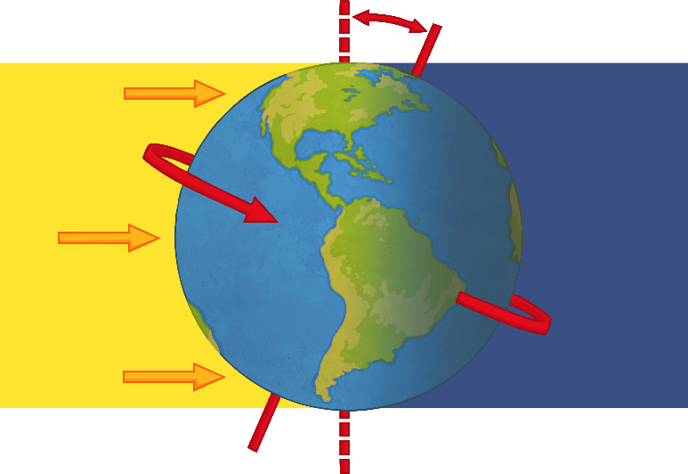
Day and Night
The Earth is tilted and spins on an invisible line called an axis.
Only half of planet Earth faces the Sun at any one time. The side facing the Sun is in daytime.
The side facing away from the Sun is in darkness and so it is night time.
It takes 24 hours for the Earth to rotate once on its axis.
If it is night time in New Zealand, what will it be in England?
It will be daytime as England is on the opposite side of the world to New Zealand and will be facing the Sun.

Slide 5
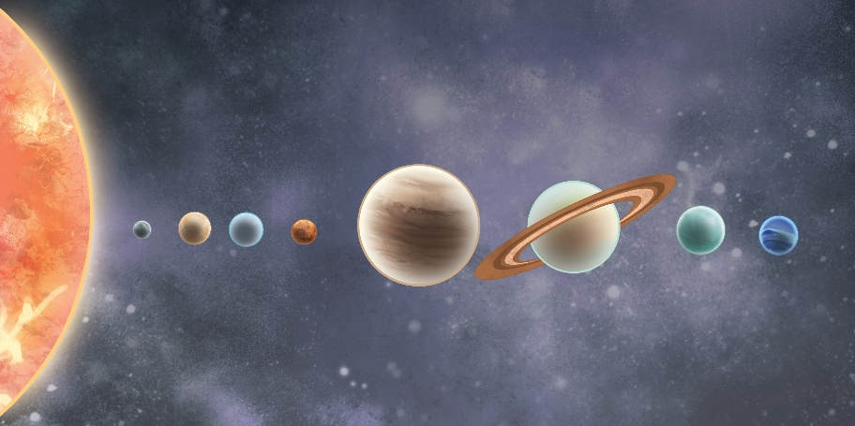
The Planets
In our Solar System, there are 8 planets.
Can you remember the order of the planets?
Mercury, Venus, Earth, Mars, Jupiter, Saturn, Uranus, Neptune
A mnemonic is a way of remembering something. We can make a sentence out of the first letter of each word in a sequence to help us remember it.
For example, we can remember how to spell ‘because’ by remembering the mnemonic: Big Elephants Can Always Understand Small Elephants.
With your partner, create your own mnemonic to help you remember the order of the planets.

Slide 6
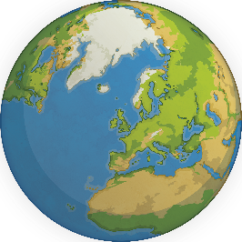
Our Solar System
In our Solar System, there are 8 planets.
What other objects might we find in space?
With your partner, you have one minute to write a list of as many objects you can think of that you may find in space.
man made satellites – Satellites made by man and sent into space to carry out a function.
natural satellite – The Moon is a natural satellite. It orbits Earth.
asteroids
comets
dust
dwarf planets

Slide 7
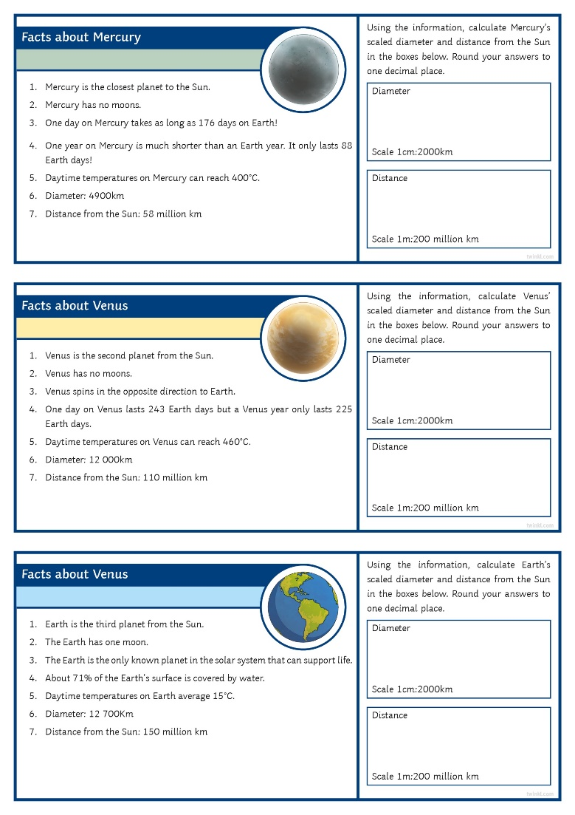
Modelling The Solar System
What is a scale model?
A scale model is a copy of something that is much larger or smaller than the object itself but one which maintains the original’s proportions. For example, a toy car which has been made to scale to represent a real life car.
It is possible to create a human scale model of the Solar System.
Using the information on the Planet Fact Cards and working in groups, calculate each planet’s scaled diameter and distance from the Sun. Round your answers to one decimal place.

Slide 8
Modelling The Solar System
Answers
Mercury Diameter:
Distance:
Venus Diameter:
Distance:
Earth Diameter:
Distance:
Mars Diameter:
Distance:
Jupiter Diameter:
Distance:
Saturn Diameter:
Distance:
Uranus Diameter:
Distance:
Neptune Diameter:
Distance:
4900 ÷ 2000 = 2.5cm
58 000 000 ÷ 200 000 000 = 0.29m
12000 ÷ 2000 = 6.0cm
110 000 000 ÷ 200 000 000 = 0.6m
12 700 ÷ 2000 = 6.4cm
150 000 000 ÷ 200 000 000 = 0.8m
6800 ÷ 2000 = 3.4cm
230 000 000 ÷ 200 000 000 = 1.2m
140 000 ÷ 2000 = 70.0cm
780 000 000 ÷ 200 000 000 = 3.9m
120 000 ÷ 2000 = 60.0cm
1400 000 000 ÷ 200 000 000 = 7.0m
51 000 ÷ 2000 = 25.5cm
2900 000 000 ÷ 200 000 000 = 14.5m
49 000 ÷ 2000 = 24.5cm
4500 000 000 ÷ 200 000 000 = 22.5m

Slide 9
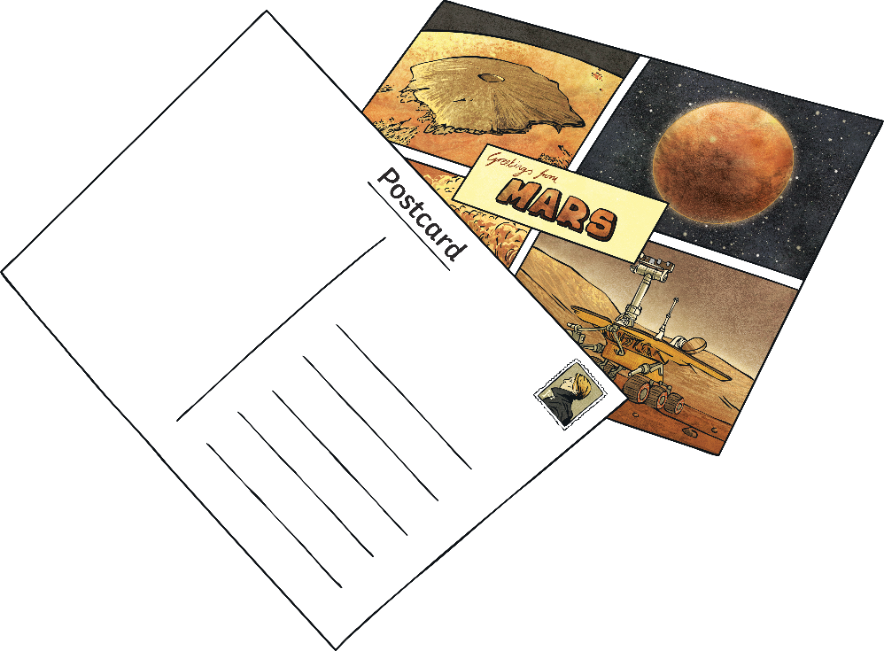
Planet Postcard
Imagine that you have taken a much-needed holiday to another planet. Using the Planet Fact Cards, write a postcard back to your family or friends on Earth describing the planet and the activities that you took part in. Try to use as many facts as you can about your chosen planet.

