Slide 2
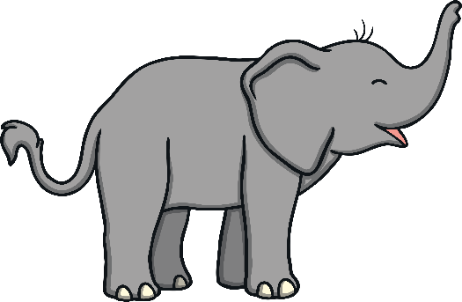
Young and old and tall and short,
Fat and thin, coloured and grey.
All of different sizes, different sizes,
But all love to play

Slide 3
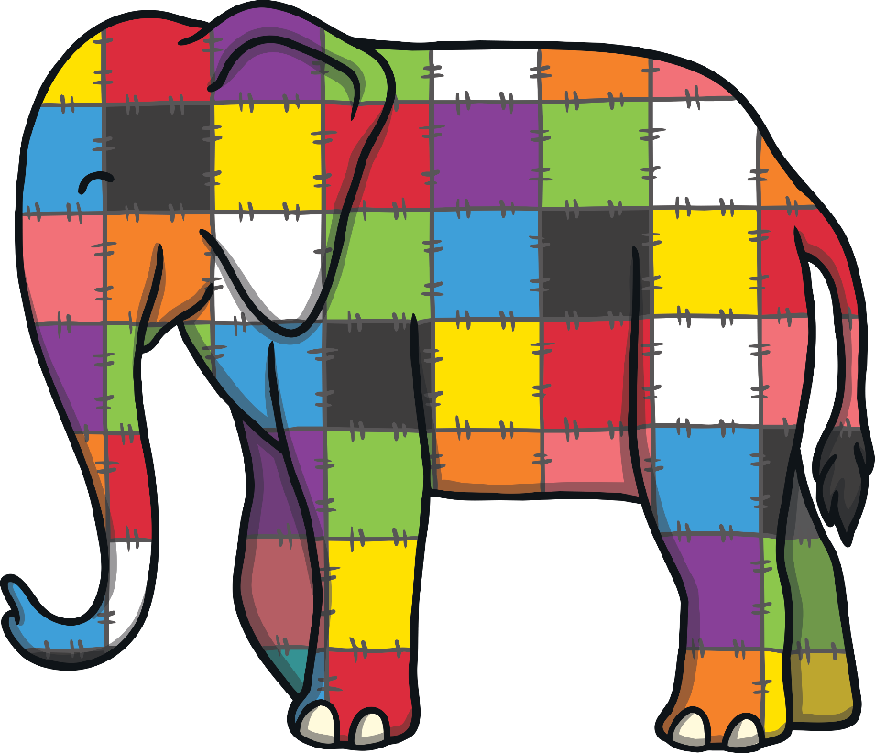
See the elephants, see the elephants,
A patchwork one you will see.
Lots of different colours, different colours,
Colourful is he.

Slide 4
Yellow, turquoise and pink is he,
Purple and orange and green.
Elmer the elephant, the elephant,
Is the one you’ve seen.

Slide 5
See the elephants, see the elephants,
A patchwork one you will see.
Lots of different colours, different colours,
Colourful is he.

