Slide 3
Year 11
Students

Slide 4
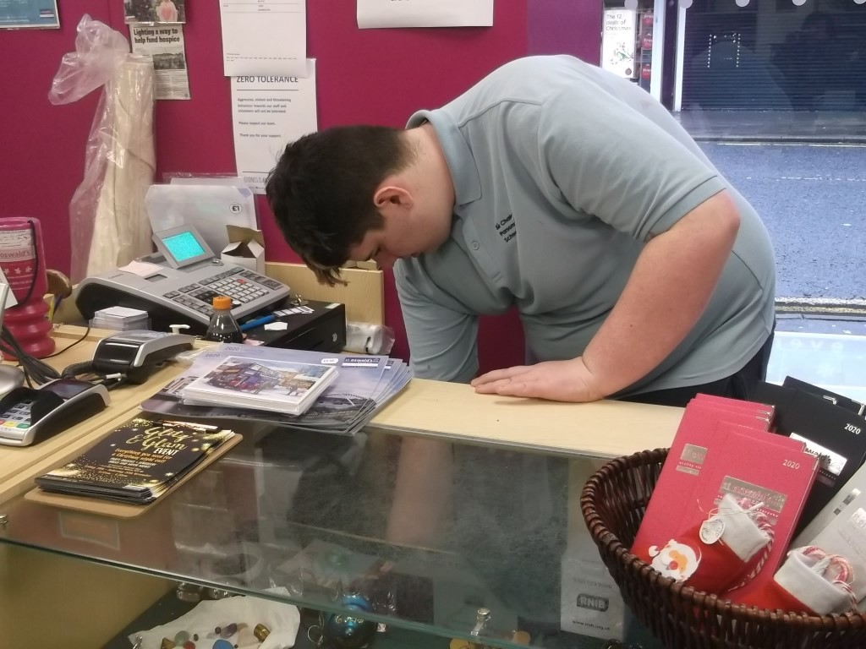
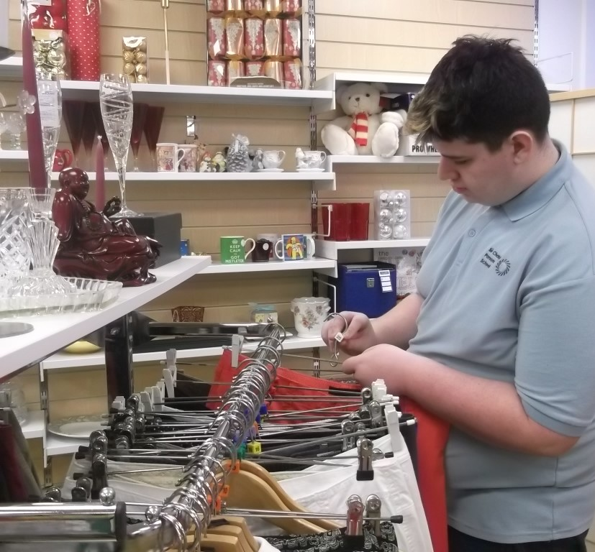
Bailey
St Oswald's

Slide 5
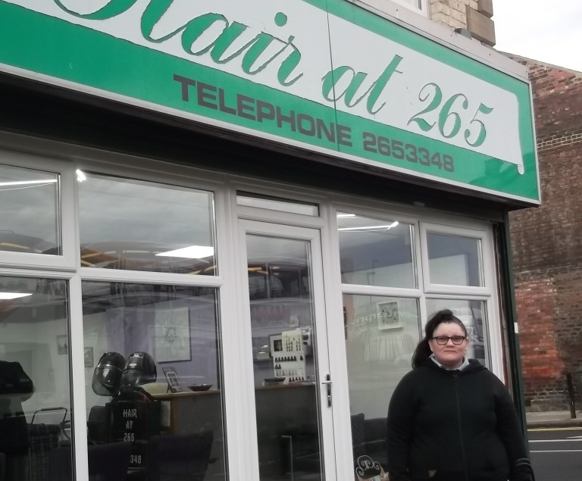
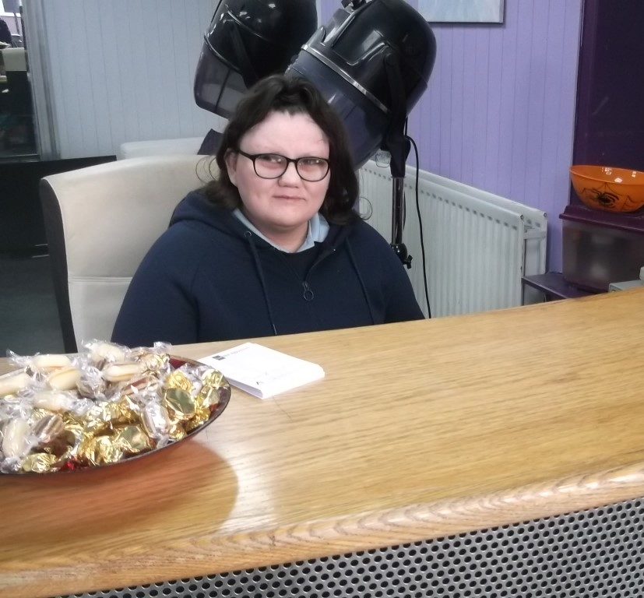
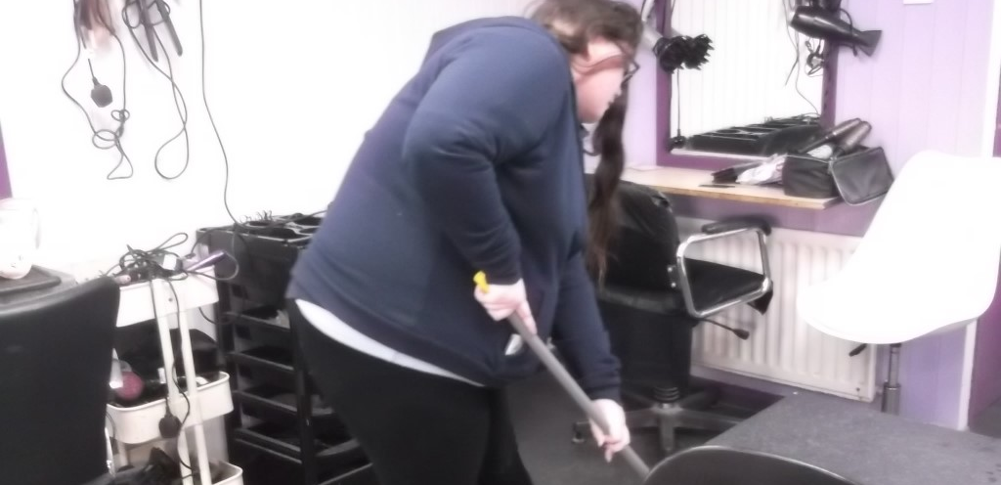
Jessica
Hair at 265
Kids Kabin

Slide 6
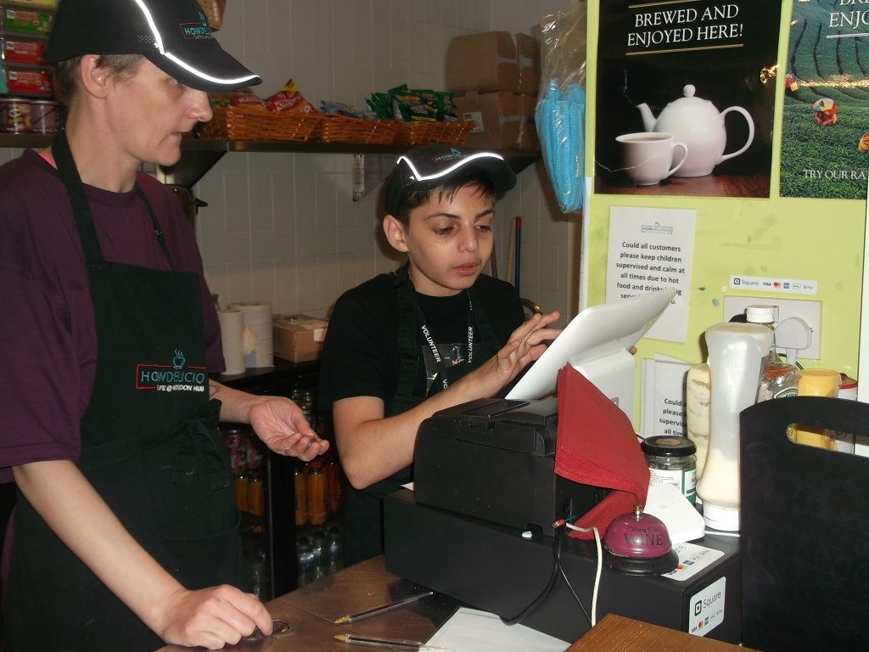
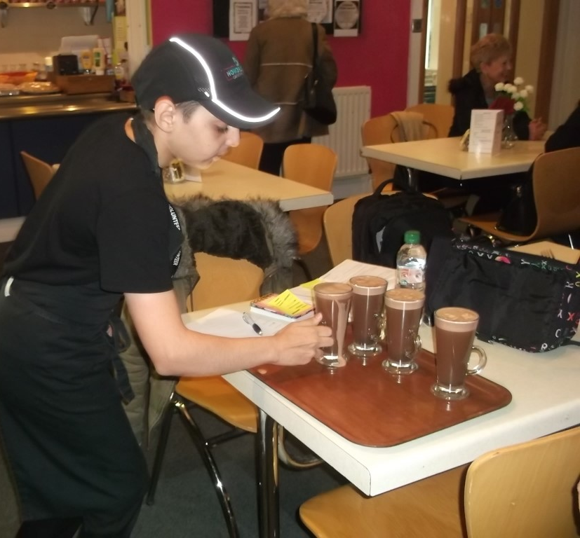
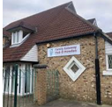
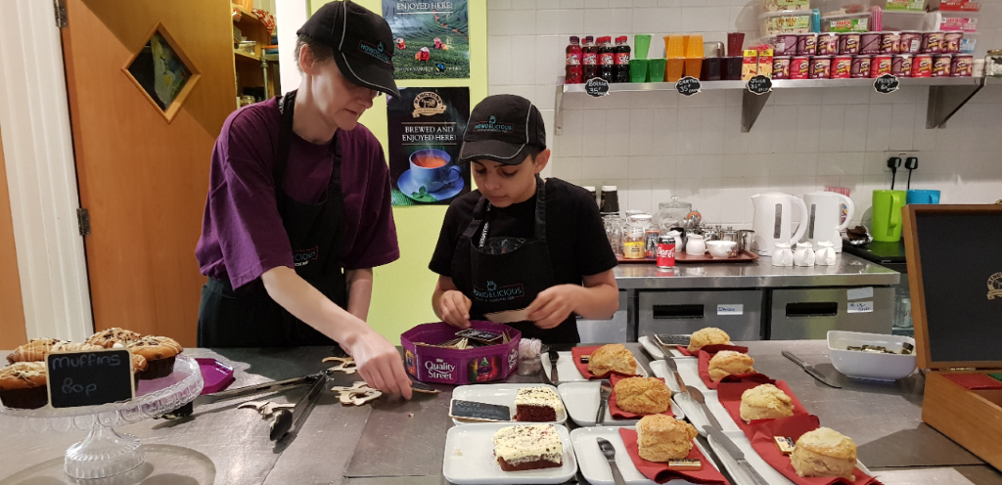
Antonio
Howden Hub Café

Slide 7
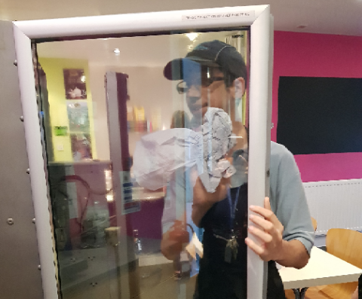
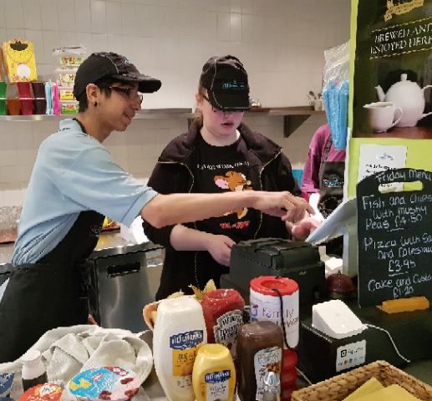
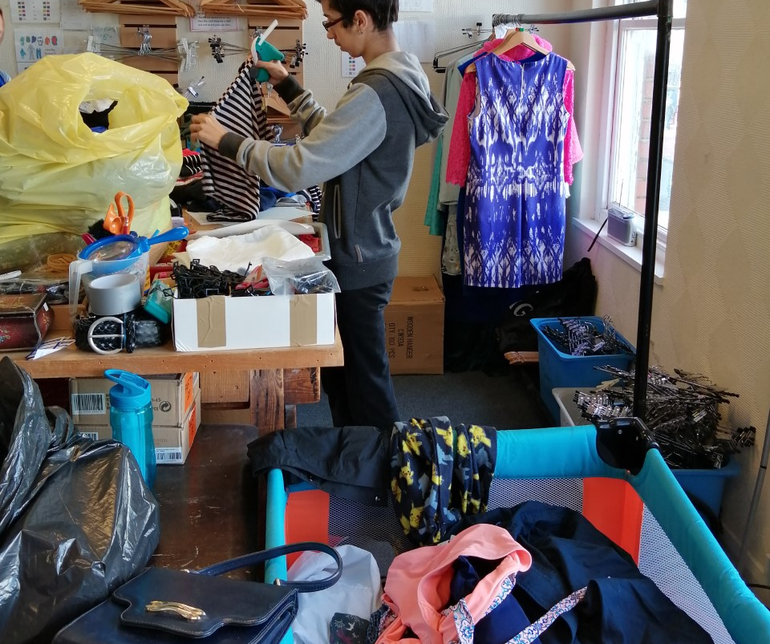
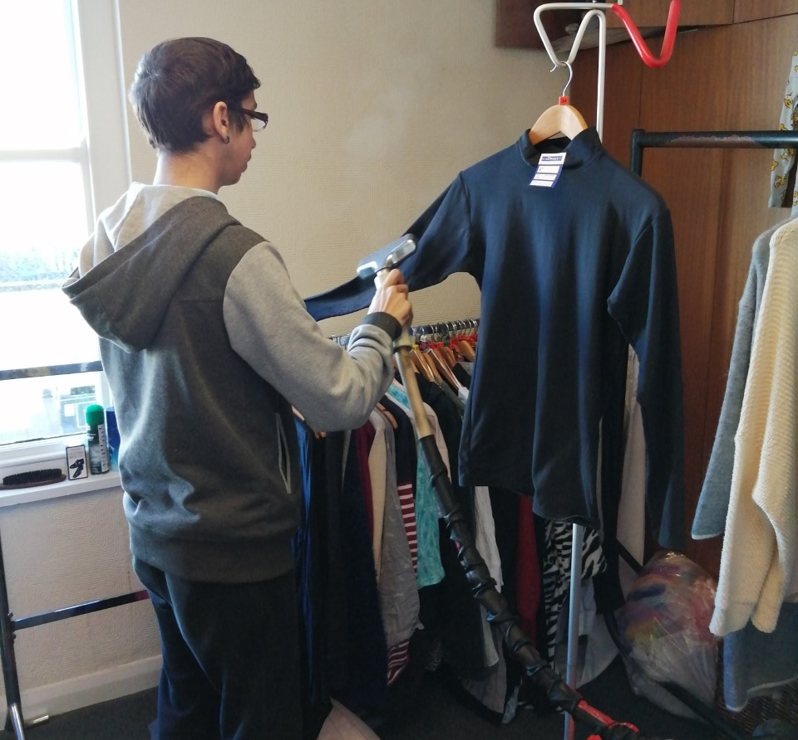
Lukas
Howden Hub Café
St Oswalds

Slide 8
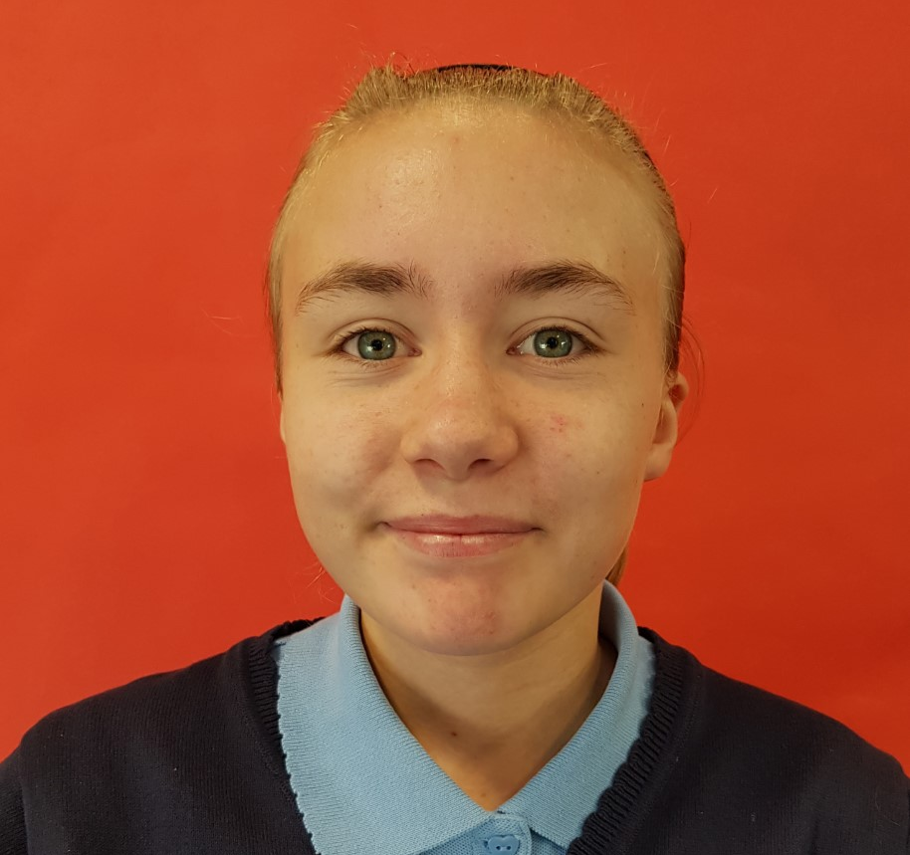
Demi
Marie Curie – Shop Assistant

Slide 9
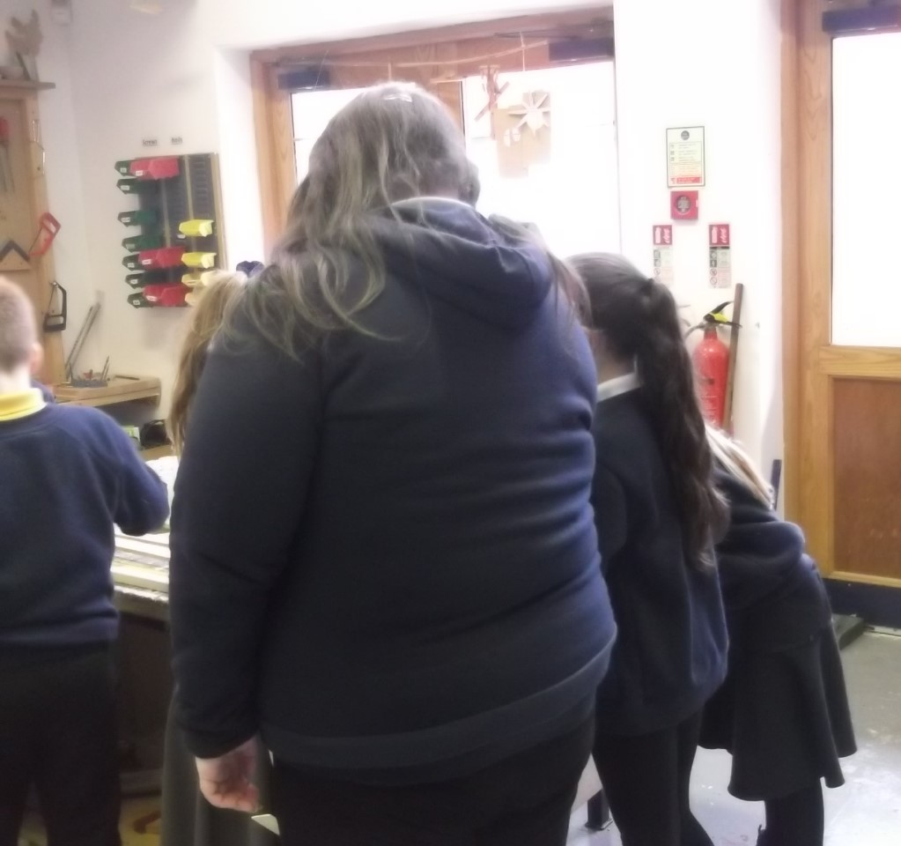
Jessica
Kids Kabin

Slide 10
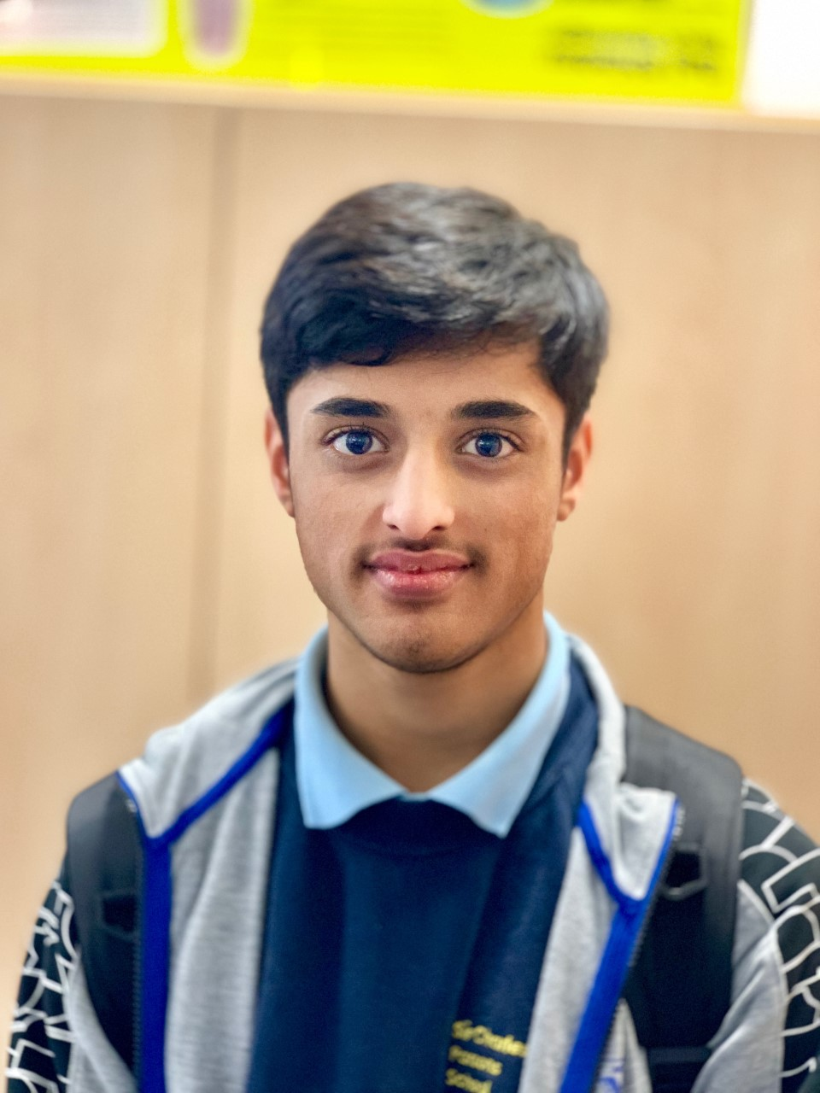
Hassan
Sir Charles Parsons School
PE Department

Slide 11
SCP Sixth Form Students
Work Related Learning Experience

Slide 12
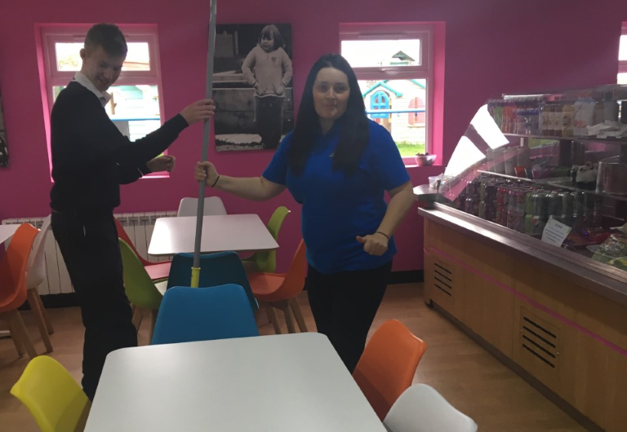
Thomas
The Tim Lamb Centre

Slide 13
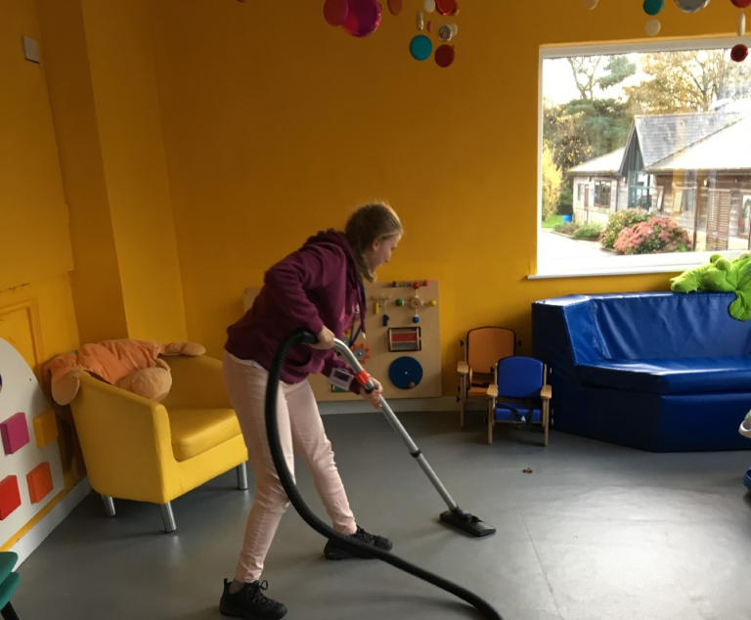
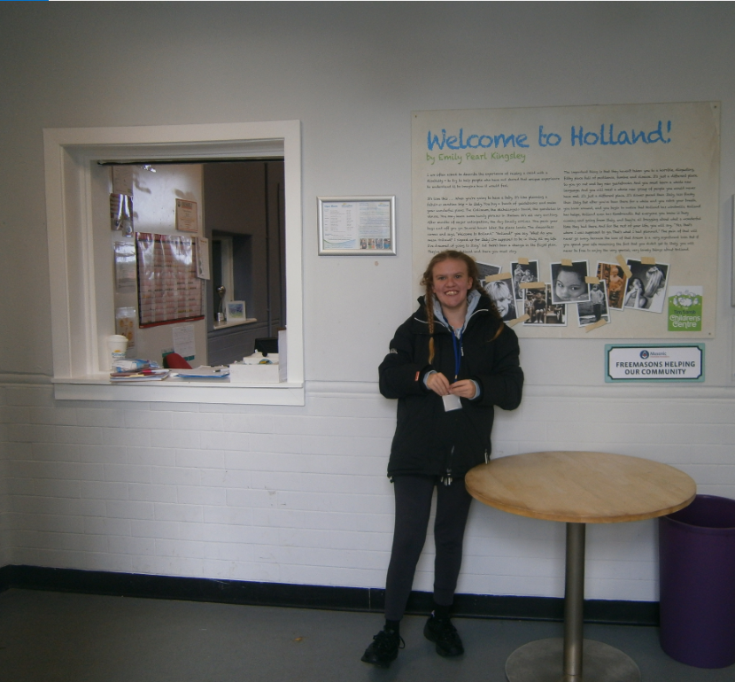
Rebecca
The Tim Lamb Centre

Slide 14
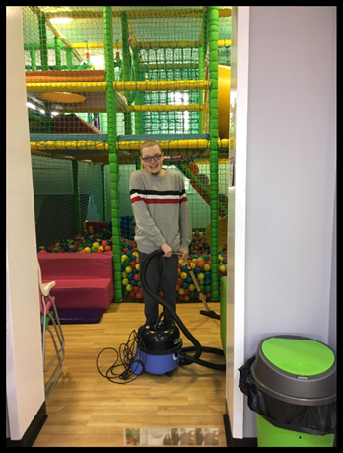
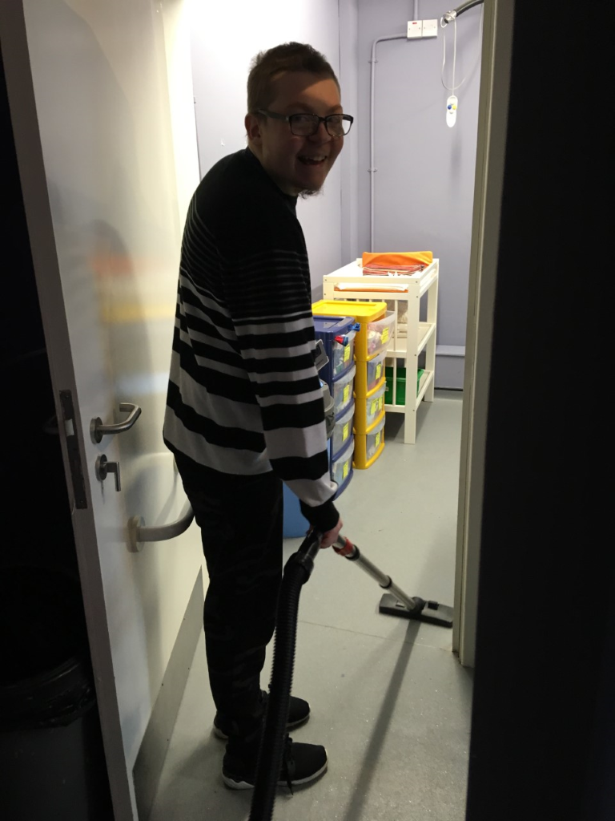
Danny
The Tim Lamb Centre

Slide 15
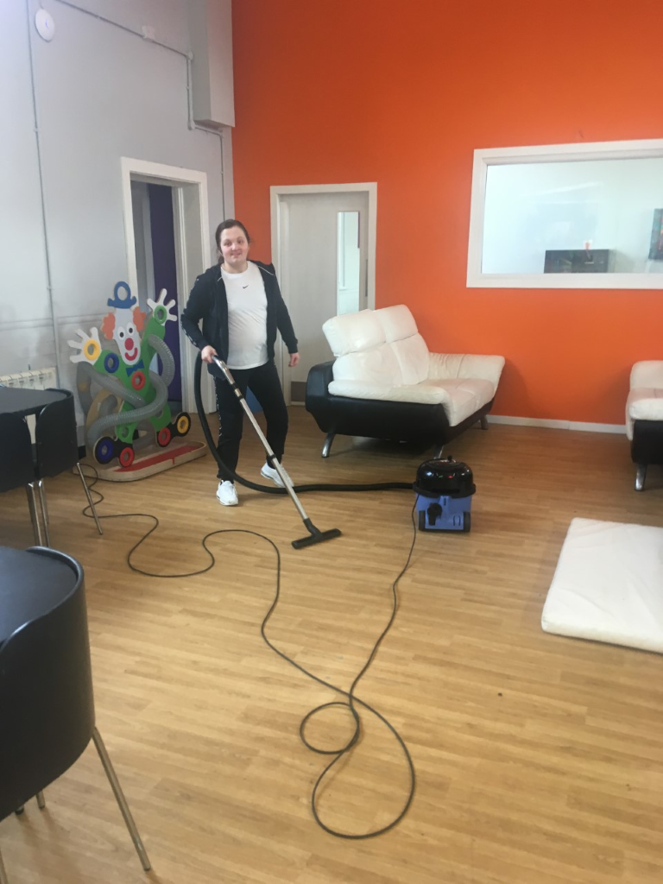
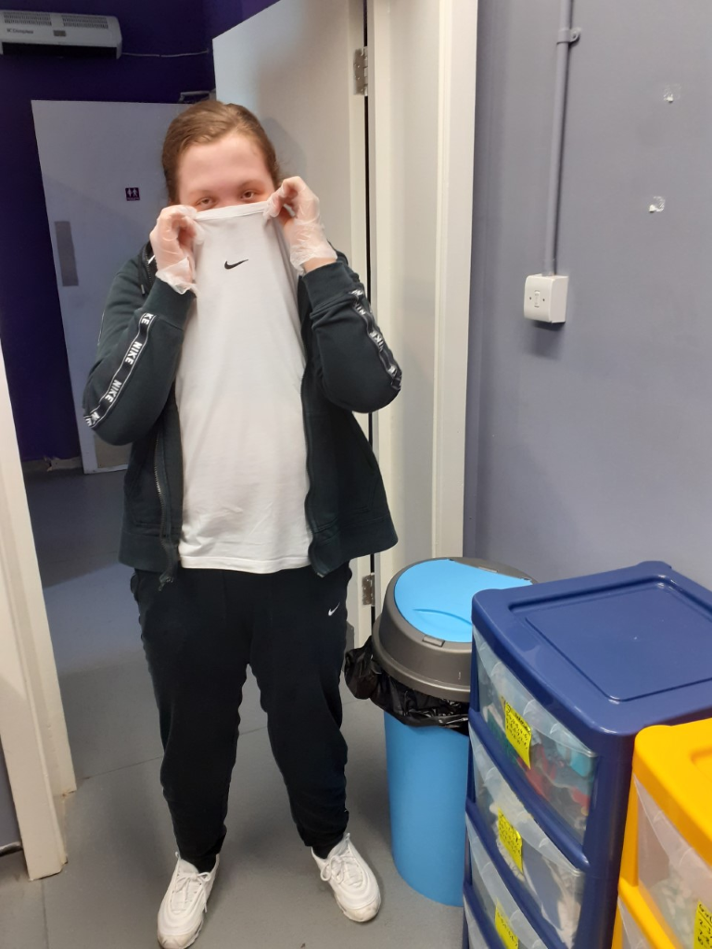
Letalia
The Tim Lamb Centre

Slide 16
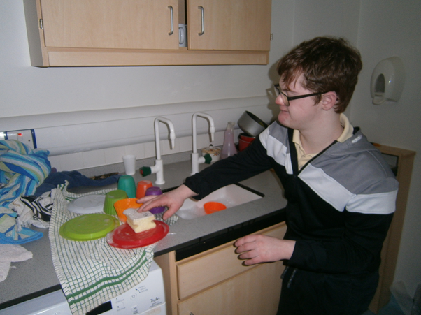
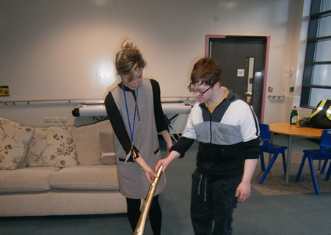
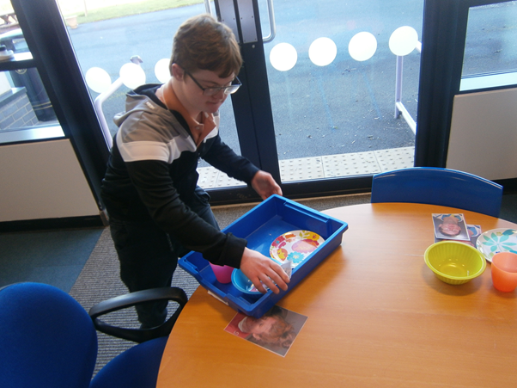
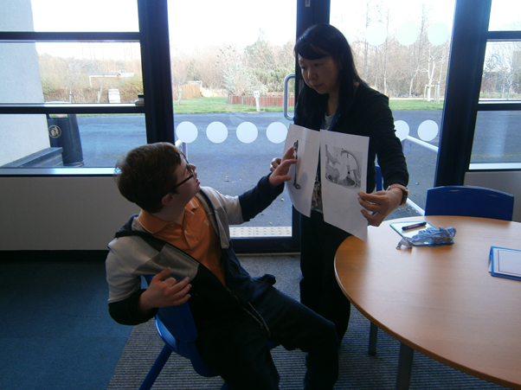
Daniel

Slide 17
Year 12 Students
Work experience placements

Slide 18
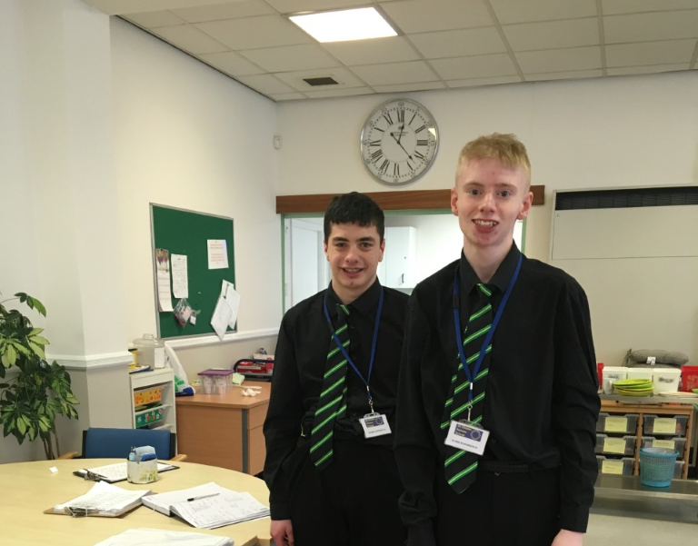
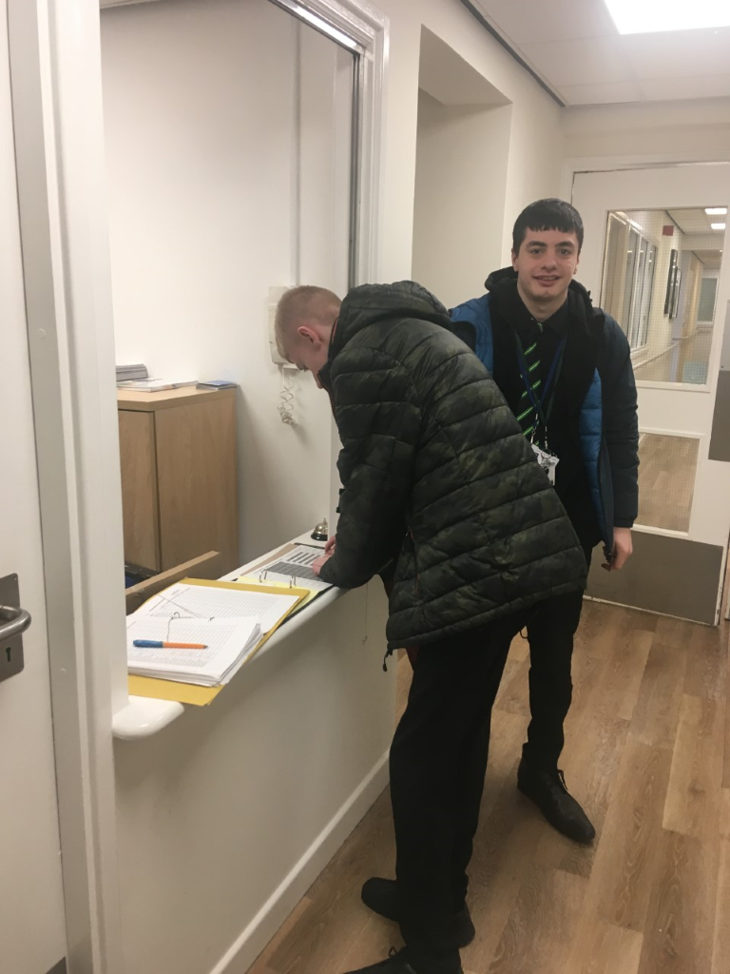
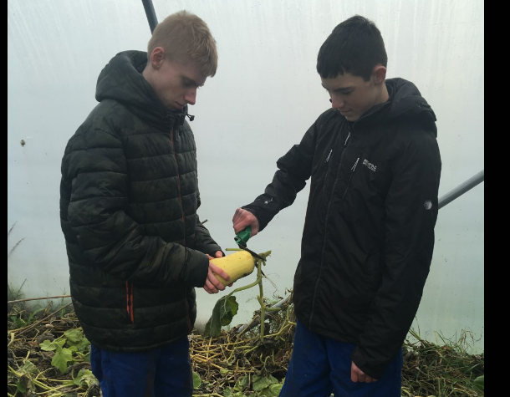
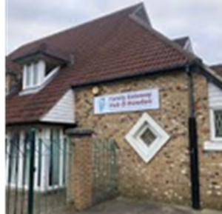
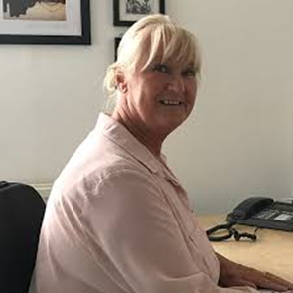
Paul
Howdon Hub Gardens
St Anthony of Padua care home

Slide 19
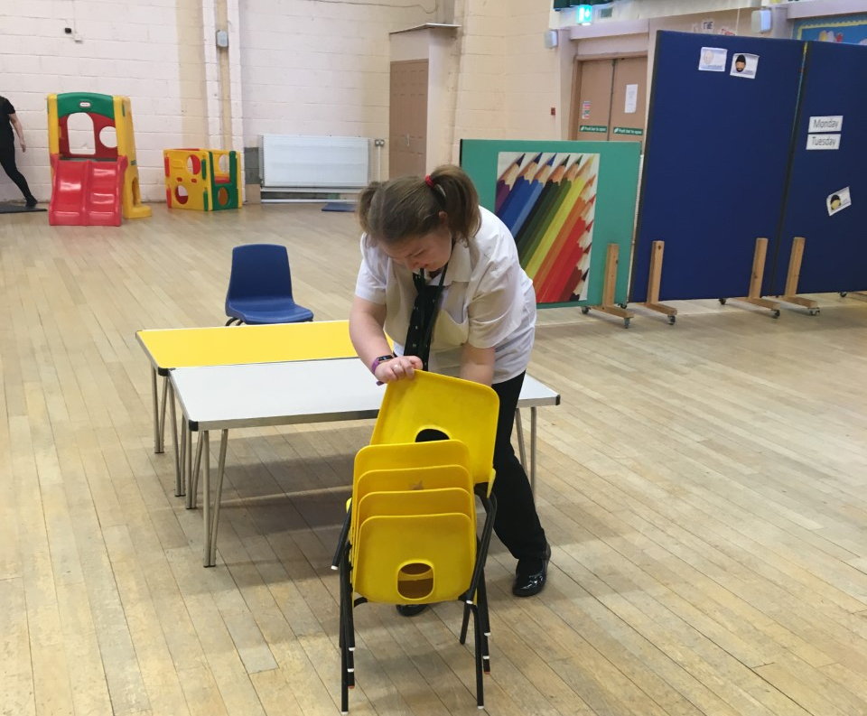
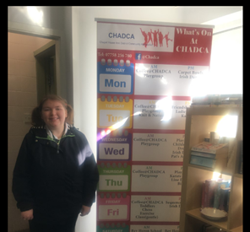
Natasha
CHADCA Children's Playgroup

Slide 20
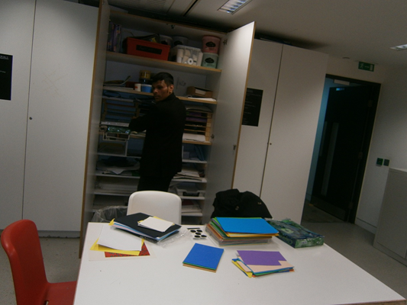
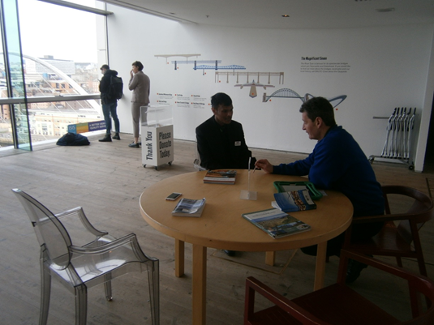
Tahir
Baltic

Slide 21
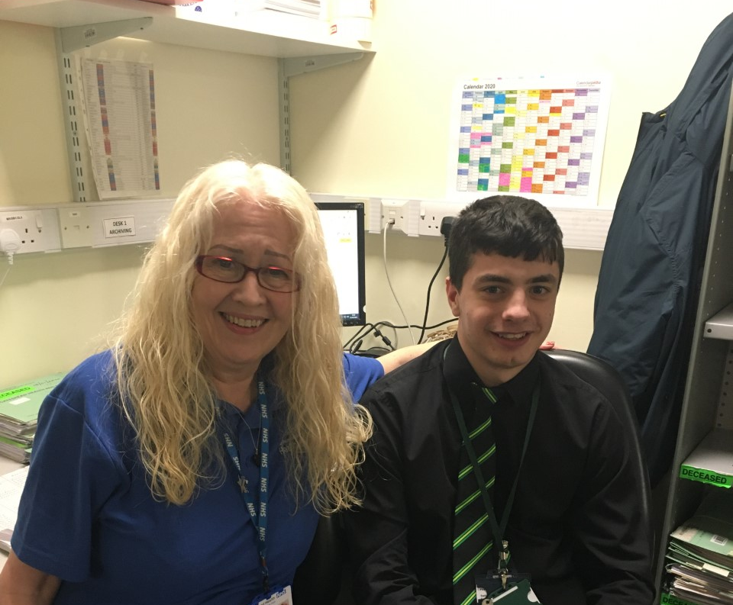
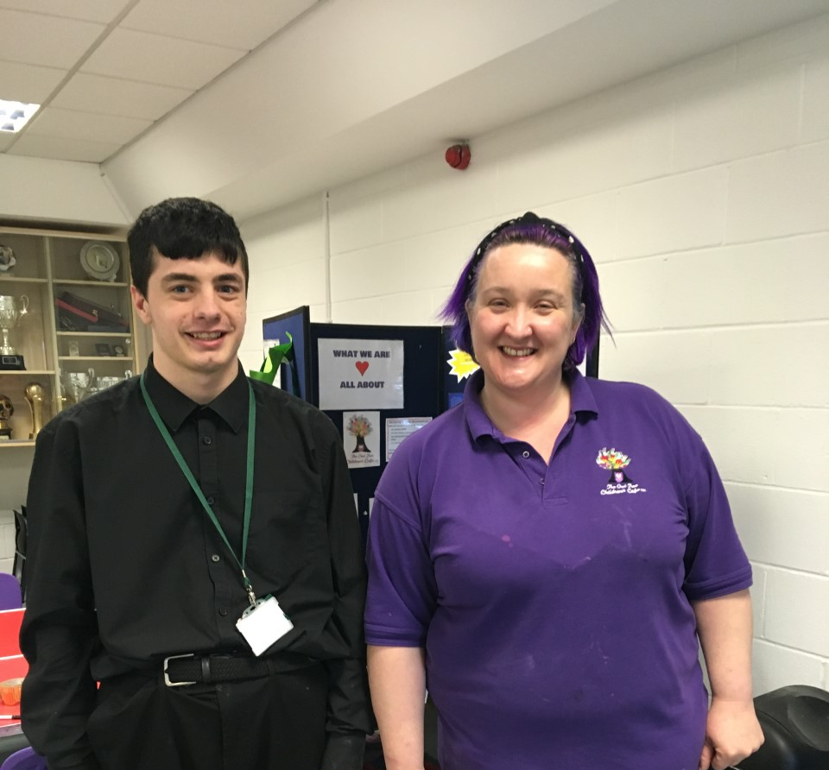
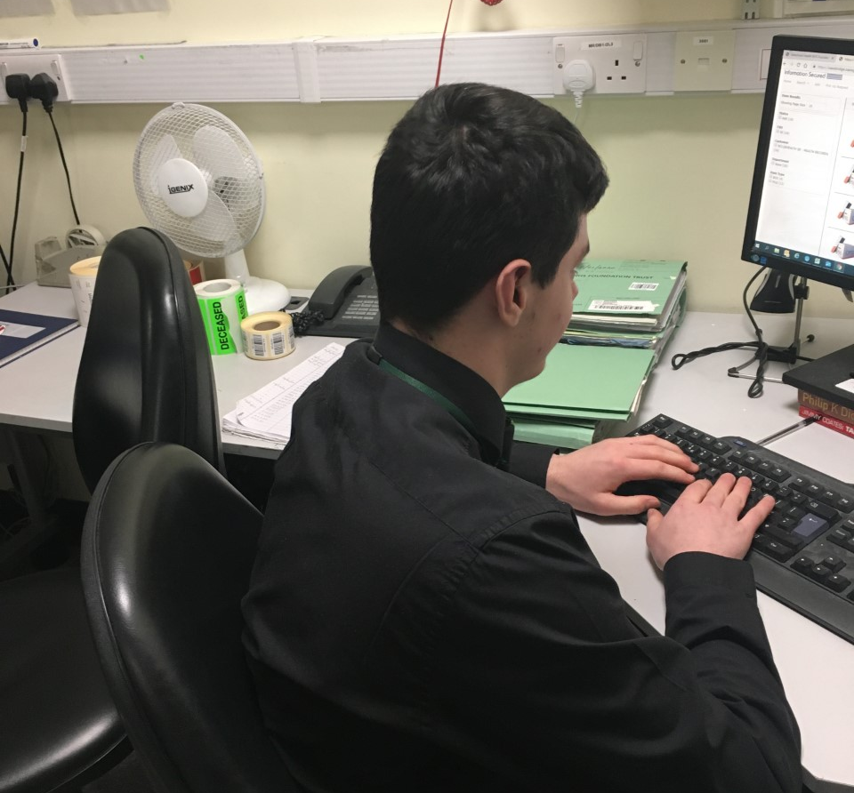
Kierian
St Anthony of Padua
Owl Tree Childrens Centre
Project Choice NHS – QE Hospital Medical Records

Slide 22
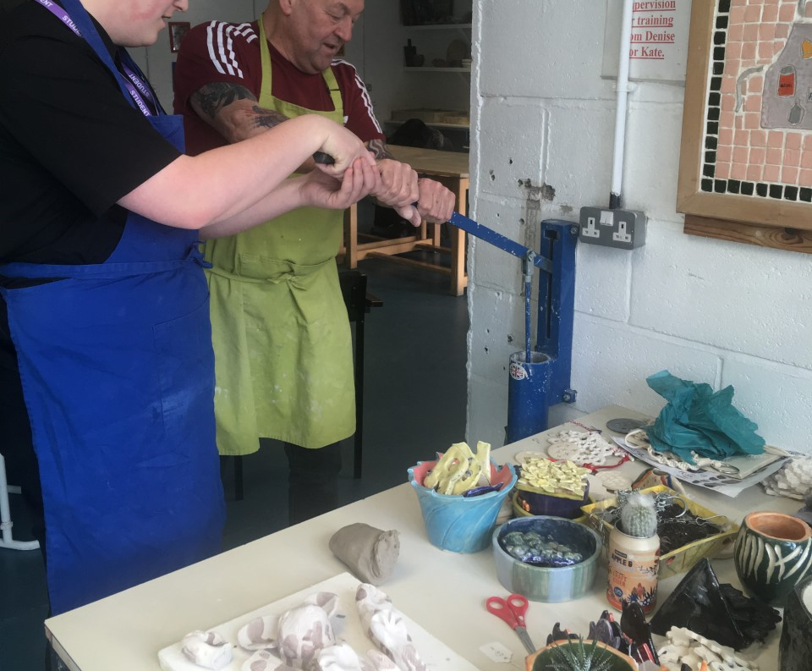
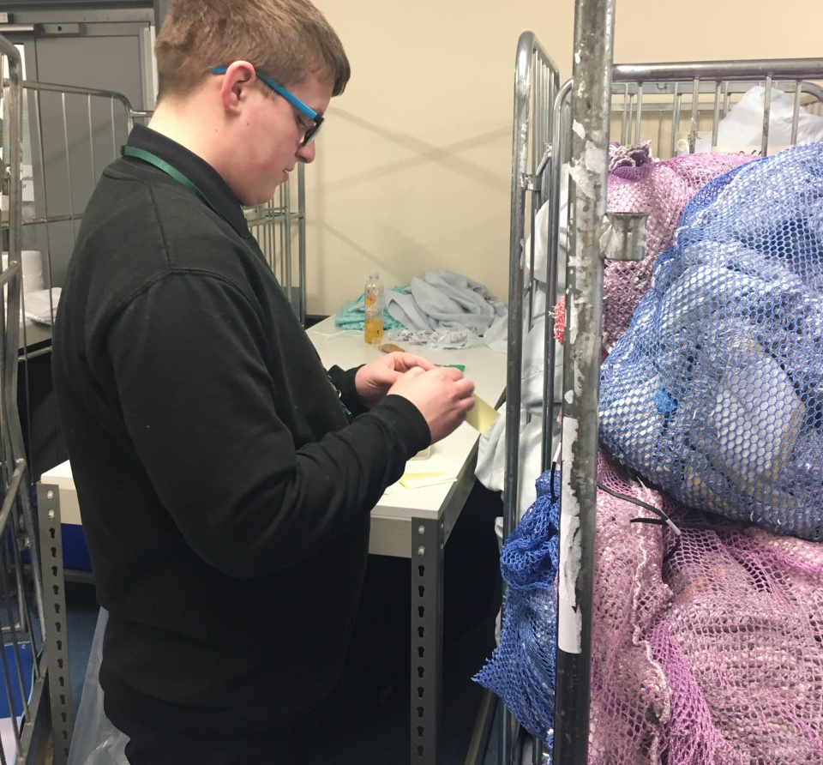
Jack
Project Choice NHS – RVI Hospital Linen Department
Hedleys Able 2 - Support Assistant

Slide 23
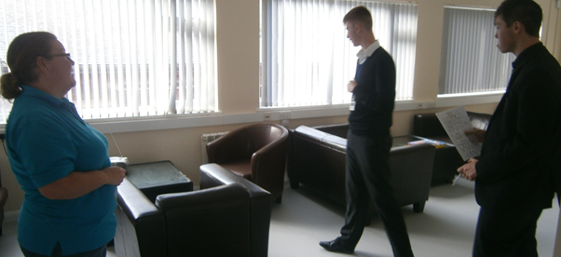
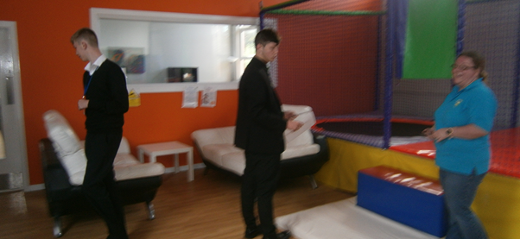
Richard
The Tim Lamb Centre - Admin

Slide 24
Year 13 Students
Work Experience Placements

Slide 25
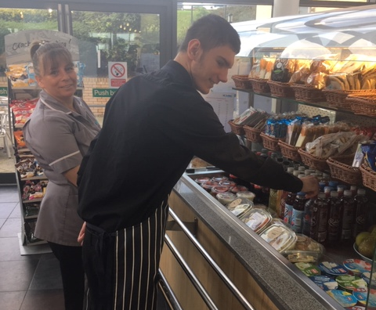
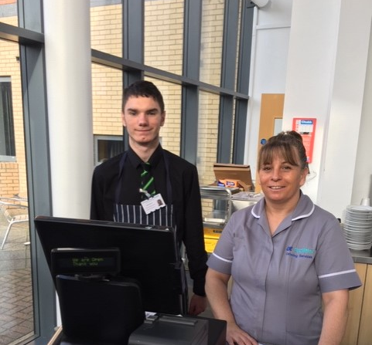
Jordon
Project Choice NHS – QE Hospital Treatment Café

Slide 26
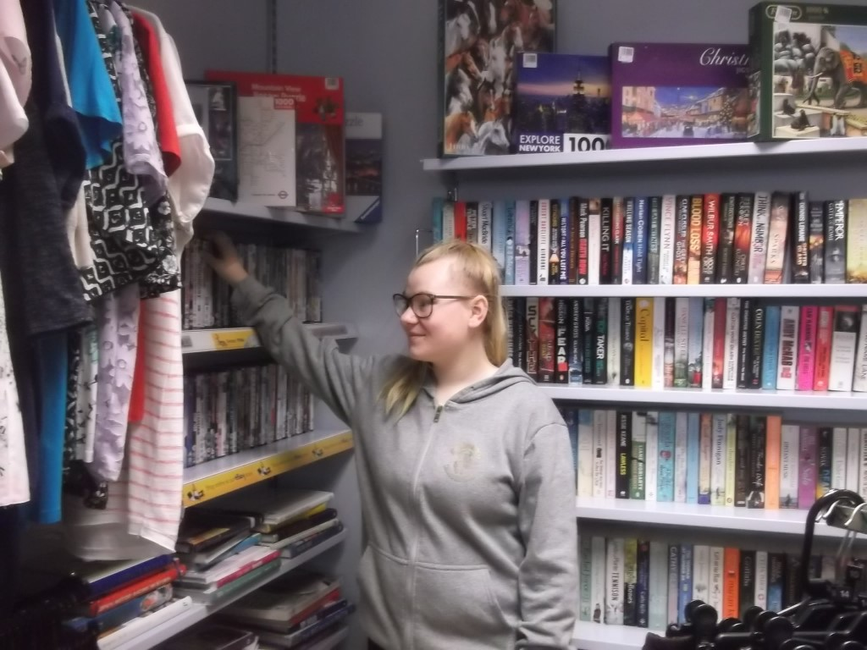
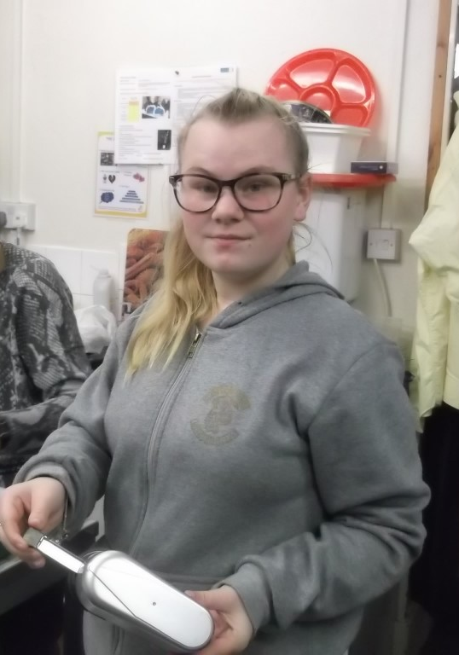
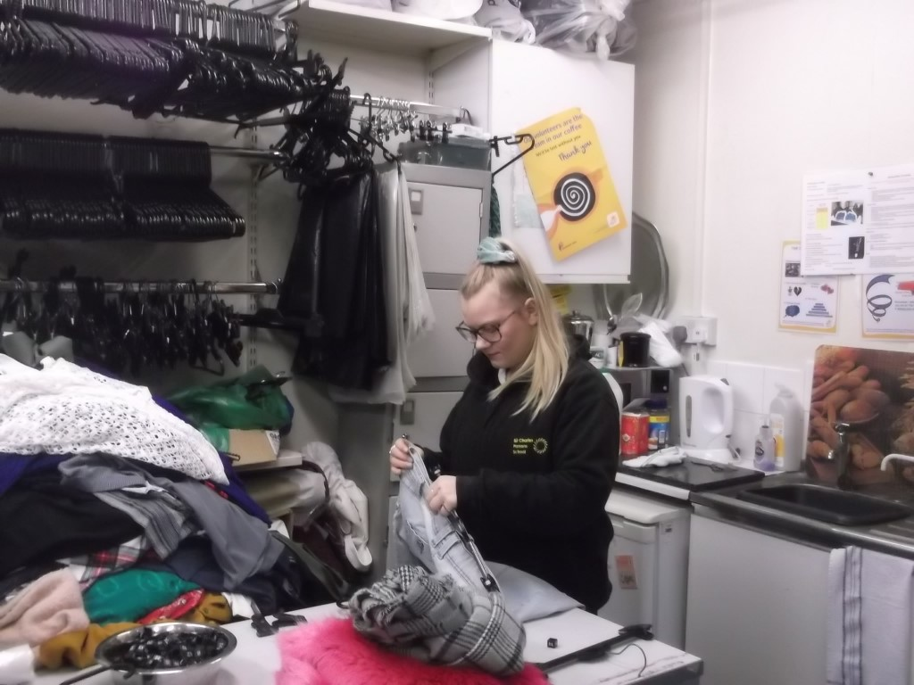
Celisa
Marie Curie - Shop Assistant

Slide 27
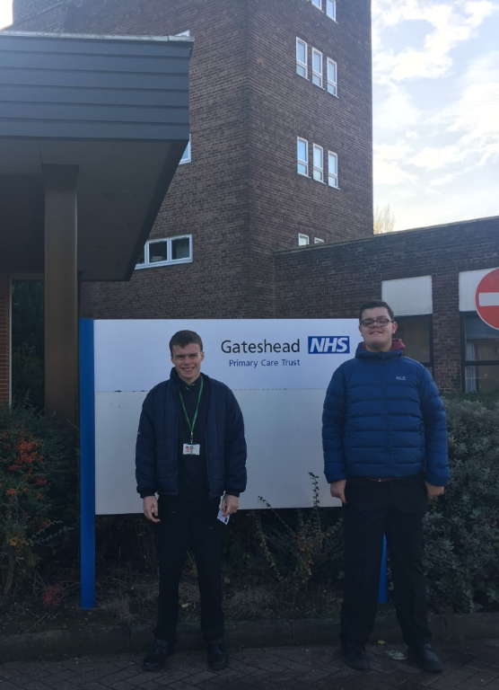
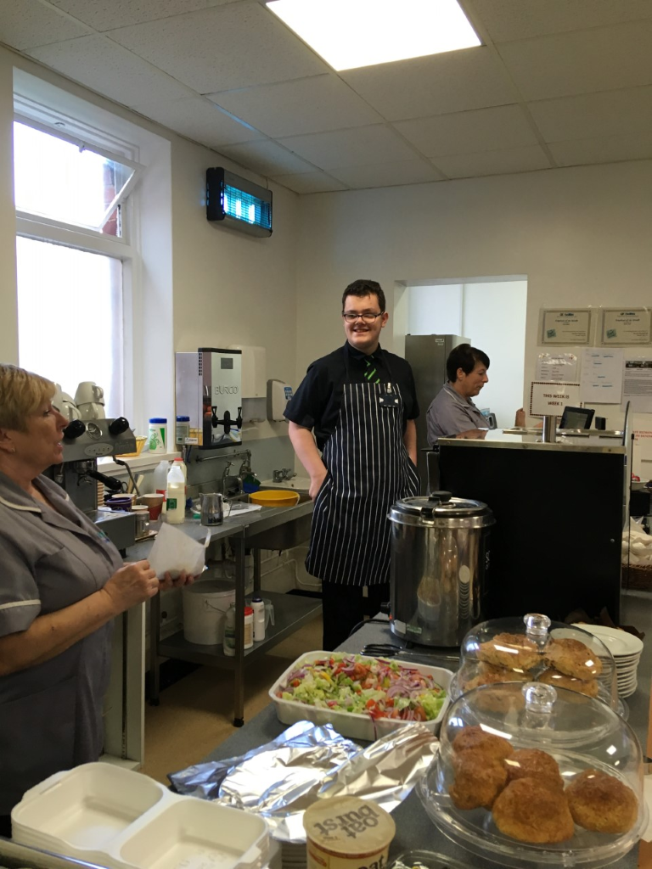
David
Project Choice NHS Bensham Hospital Cafe

Slide 28
Ryan
Project Choice NHS – Bensham Hospital Café
St Anthony of Padua Care home

Slide 29
Alex
Project Choice NHS QE Hospital Breast and Bowel Screening Department

Slide 30
Kyle
Vision for Education - Admin

Slide 31
Aiman
Marie Curie – Shop Floor Assistant
Project Choice NHS – QE Hospital Medical Records Department

Slide 32
Connor
Project Choice NHS Freeman Hospital Linen Department

Slide 33
Courtney
Project Choice NHS QE Hospital Treatment Café
Snack Box Café

