Slide 1
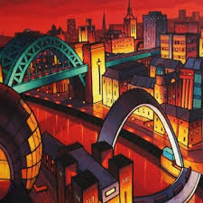
Jim Edwards

Slide 2
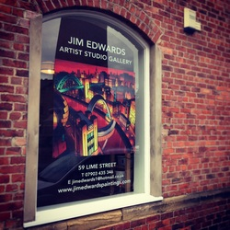
Jim Edwards
He is painter from Newcastle. His studio is in Ouseburn, not too far from here.
He paints landmarks and cityscapes of Newcastle.
He uses bright colours and abstract shapes to make his buildings.

Slide 3
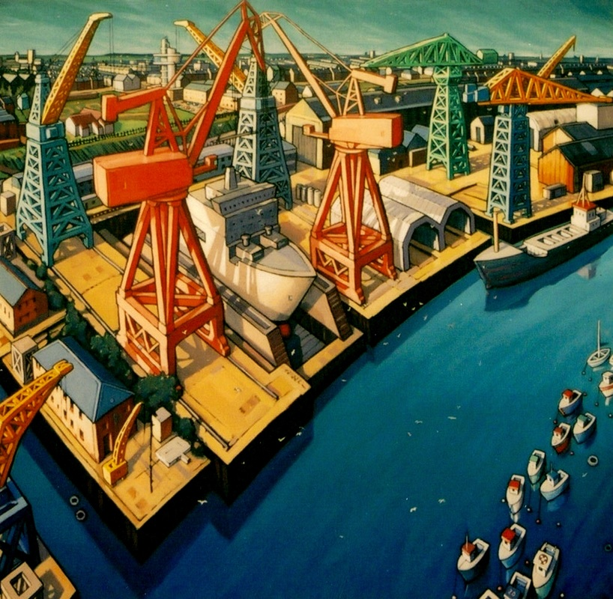
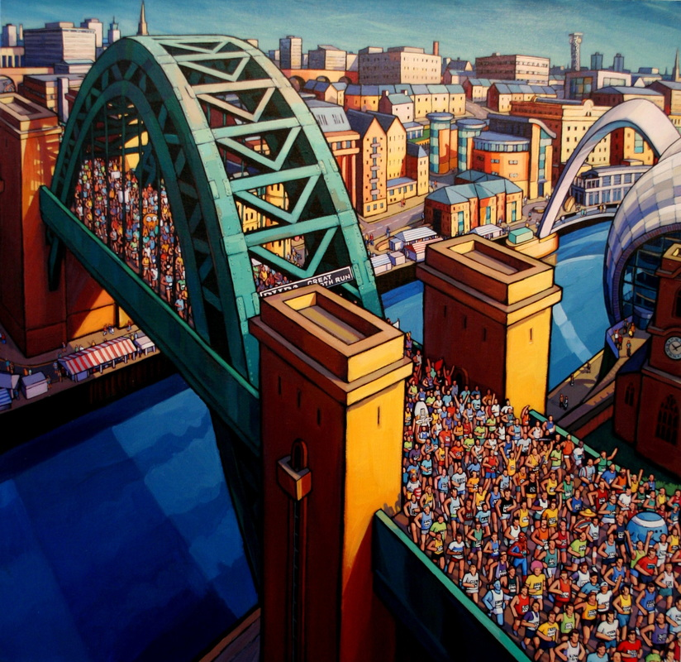
Can you guess what/where he has painted?
Where is this?
What event is this?

Slide 4
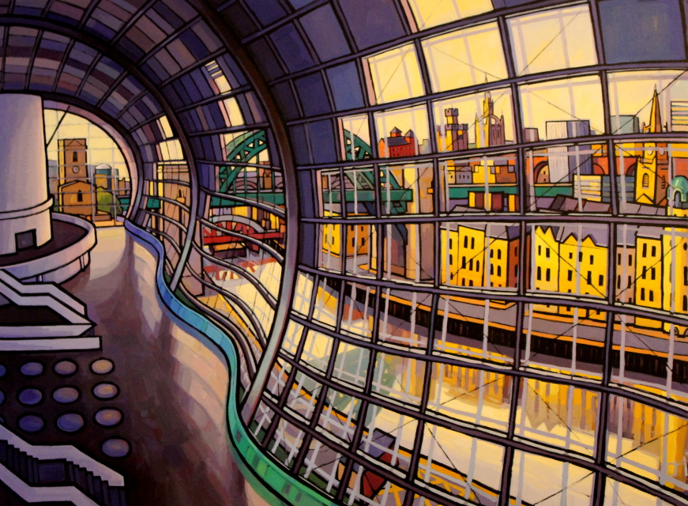
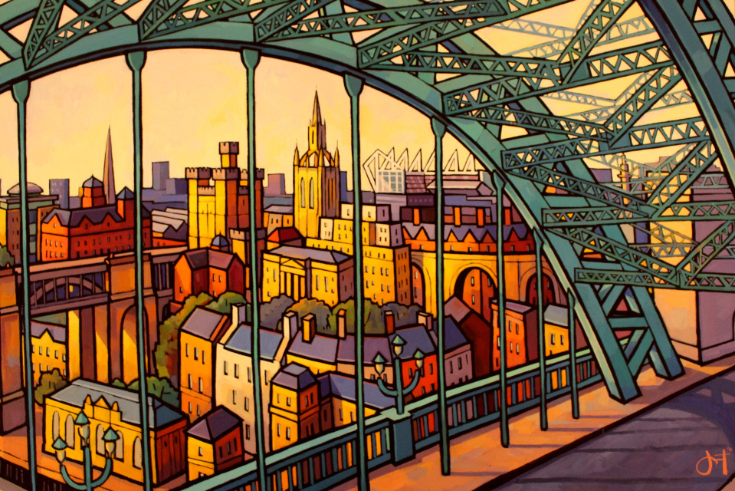
Can you guess what/where he has painted?
What building is this?
What landmarks can you see?

Slide 5
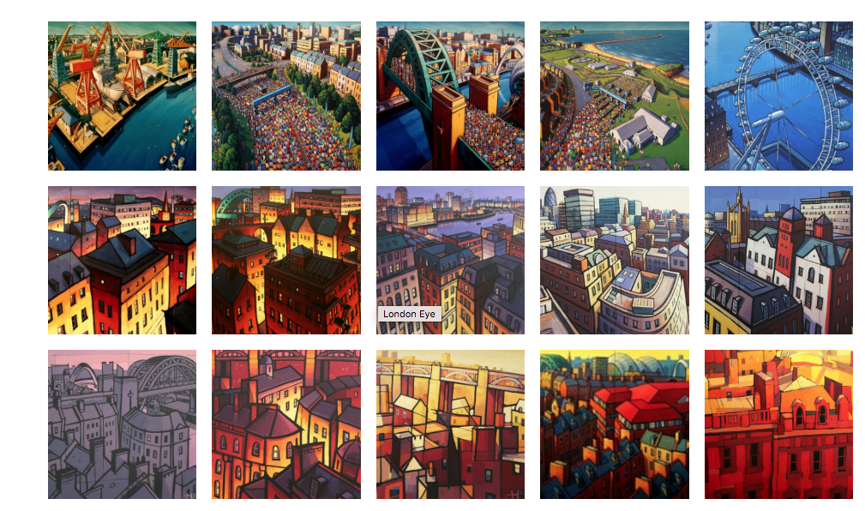
Do you like his art works? Why?
What things do you recognise?
Can you use adjective to describe his work?
What would you do to try and make a picture like this.

Slide 6
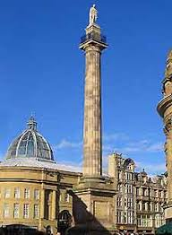
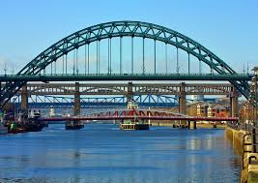
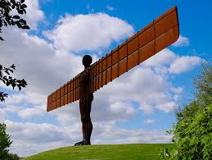
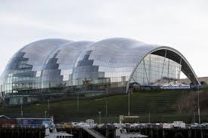
Can you make your own artwork inspired by Antony?
Try making your own artwork using bright colours.
Think about what Newcastle landmark you want to draw/colour.
Can you name some?
First use the template and colour the landmarks using bring colours, you can use felt tips, paints, crayons or water colours.
Then have a go at drawing some landmarks in Newcastle you have seen. Use a mixture of materials to colour. Make sure it’s bright.

