Slide 2
Antony Gormley
He is an artist who makes sculptures.
Sculptures are 3D art made with materials such as clay, stone and cement.
He makes casts and molds of himself to make his artwork.

Slide 3
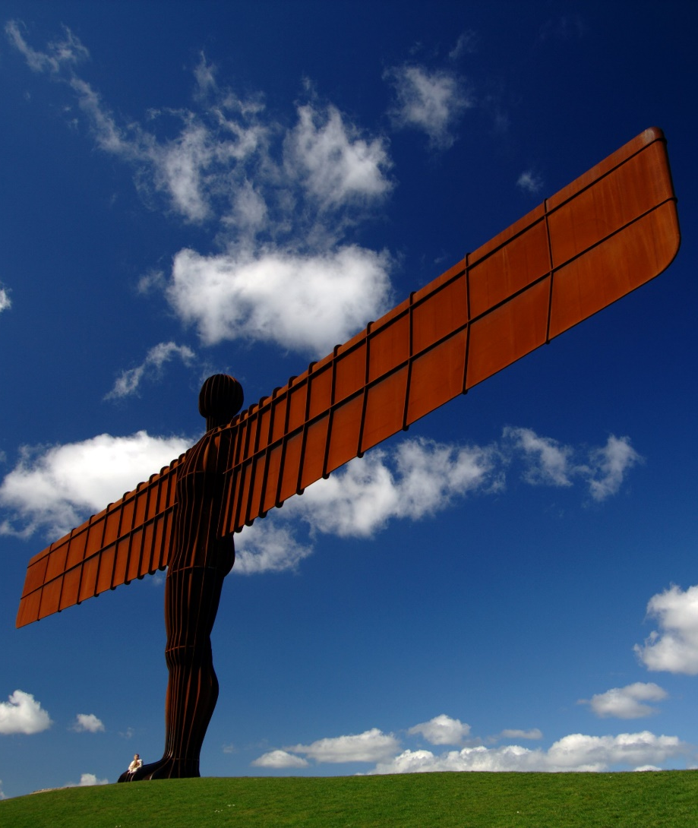
The Angel of the North, 1998
This is one of Antony’s most famous sculptures. It is on the top of a hill next to the A1 in Gateshead in the north east of England.
It is 20 metres high and its wingspan is 54 metres. It weighs 200 tonnes. Underneath the hill are concrete piles 20 metres deep to keep the angel in place.
Explaining why he chose to make a sculpture of an angel, he said, “No one has ever seen one and we need to keep imagining them.”
Did You Know?
The angel’s wingspan is the same size as that of a jumbo jet plane!

Slide 4
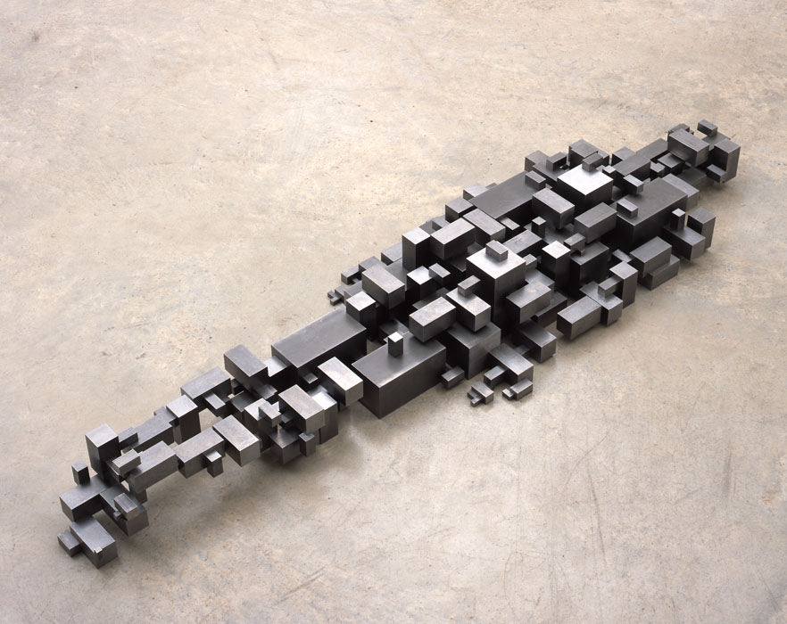
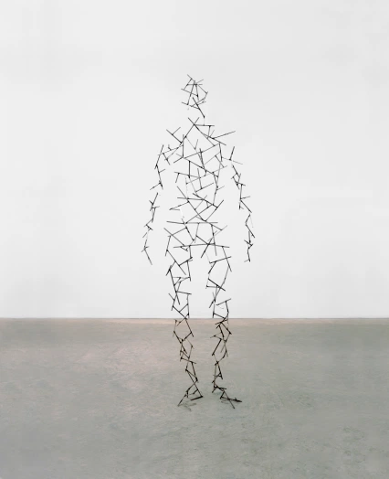
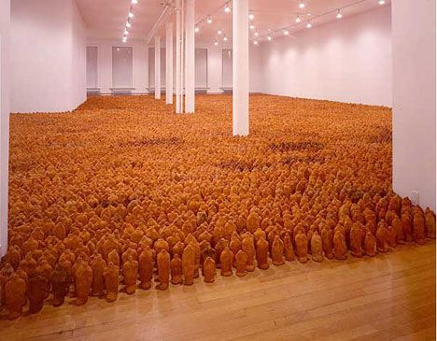
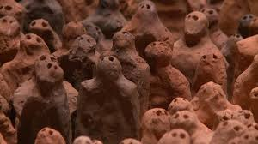
His other artworks
Settlement
Domain
Do you like these sculptures? Why?
Can you use describing words to describe them?
How could you make these at home?
What objects, materials or toys would you use?
Fields

Slide 5
Can you make your own artwork inspired by Antony?
Try making your own artwork using objects, materials and other things in your house.
If possible, you can go outside to collect things from your garden.

Slide 6
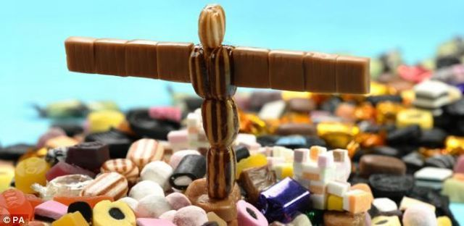
Can you make your own Angel of the North?
What could you use to make your own?
Lego, sweets, sticks, playdough, clay?
How big can you make it?
Can you make the wings really big?
See how many different angels you can make.

Slide 7
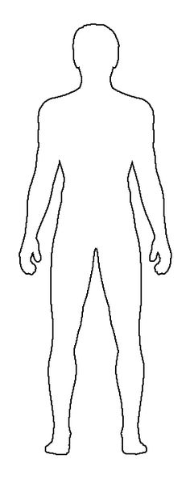
Can you make this?
If you can, collect sticks from outside to help make this. What else could you use that is similar to a stick?
You could draw lines on your figure using pens, felt tip or crayons.
Use the template of the figure and glue on the sticks (or whatever you decide to use). Once filled, cut out the figure.
Can you draw your own template of a figure for more
Where could you display this? Outside for other people to see? In your garden?

Slide 8
Can you make this?
Using clay or blu tac or playdough, can you have a go at making these sculptures.
How many can you make?
What does it feel like?
Can you make them different shapes and sizes?
Where can you leave them? Maybe in your house or on your next walk?
https://www.yummytoddlerfood.com/activities/playdough-recipe/ (no flour playdough)

Slide 9
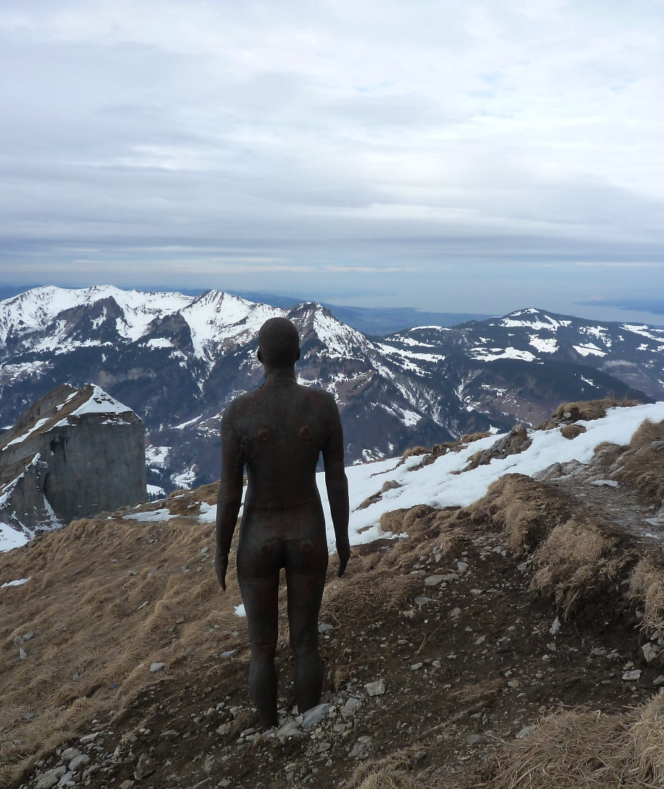
Try It Yourself
Why not try creating your own sculptures inspired by the work of Antony Gormley?
You could use different material, such as clay or playdough, to make body shapes. Experiment with grouping them in different numbers and putting them in different places. You could add wings to make your own angels of the north, south, east or west!

