Slide 1
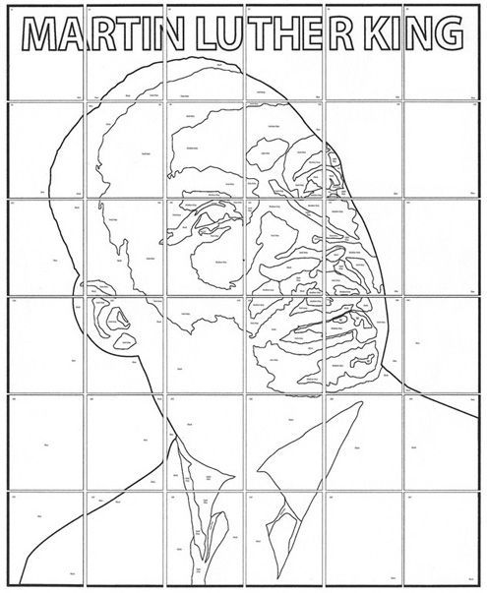
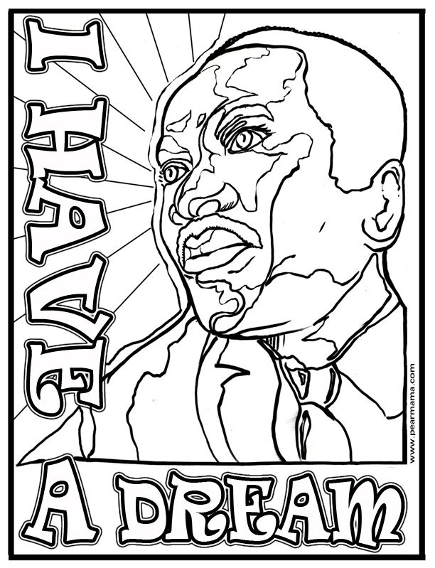
Colour using bright colours

Slide 2
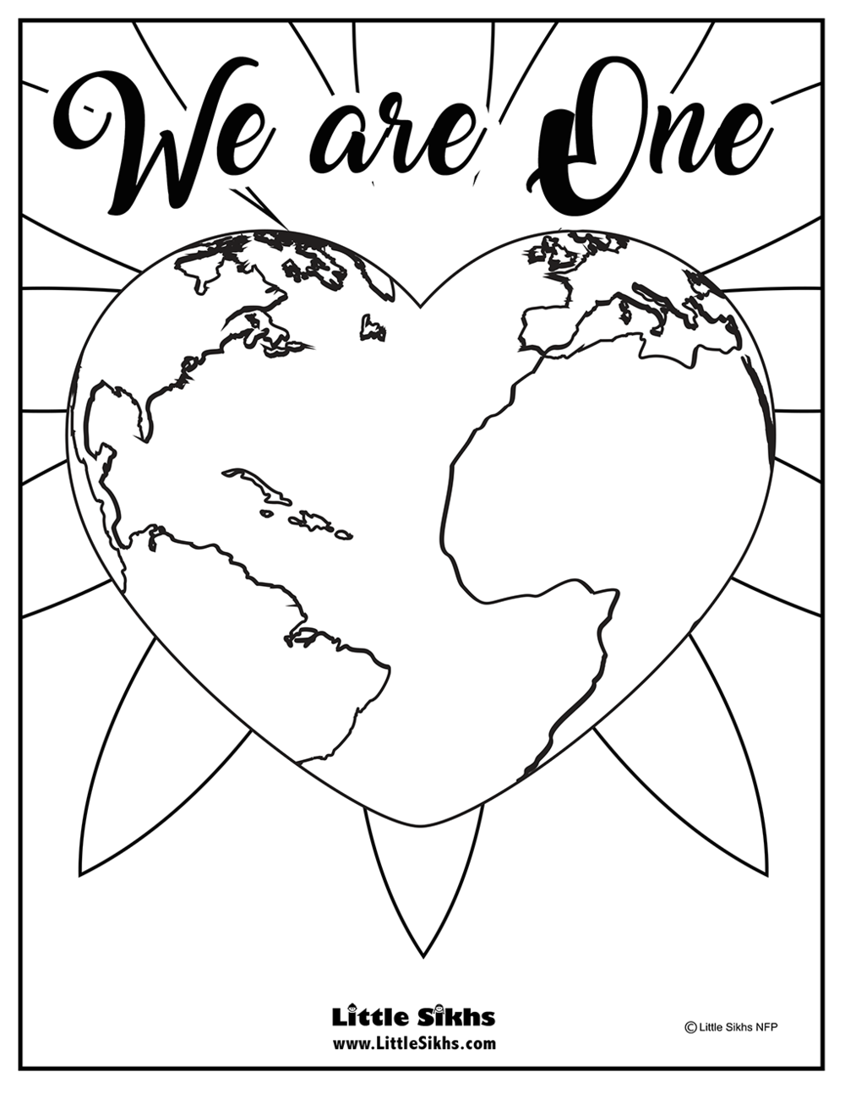
Print out and colour/paint or collage

Slide 3
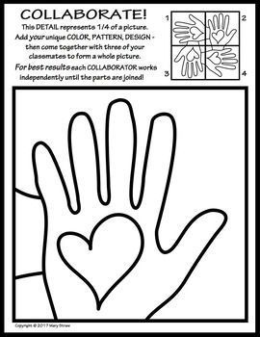
Create a picture to represent unity.
Print off the picture x4 and colour, paint, collage each one differently.
Put the pictures together once they are finished to see what they look like.

Slide 4
Create a racial equality and diversity picture using images of different faces from magazines. Cut the faces into strips of five. Place the pieces together in the correct order.
Forehead
Eyes
Nose
Mouth
Chin/neck

Slide 5
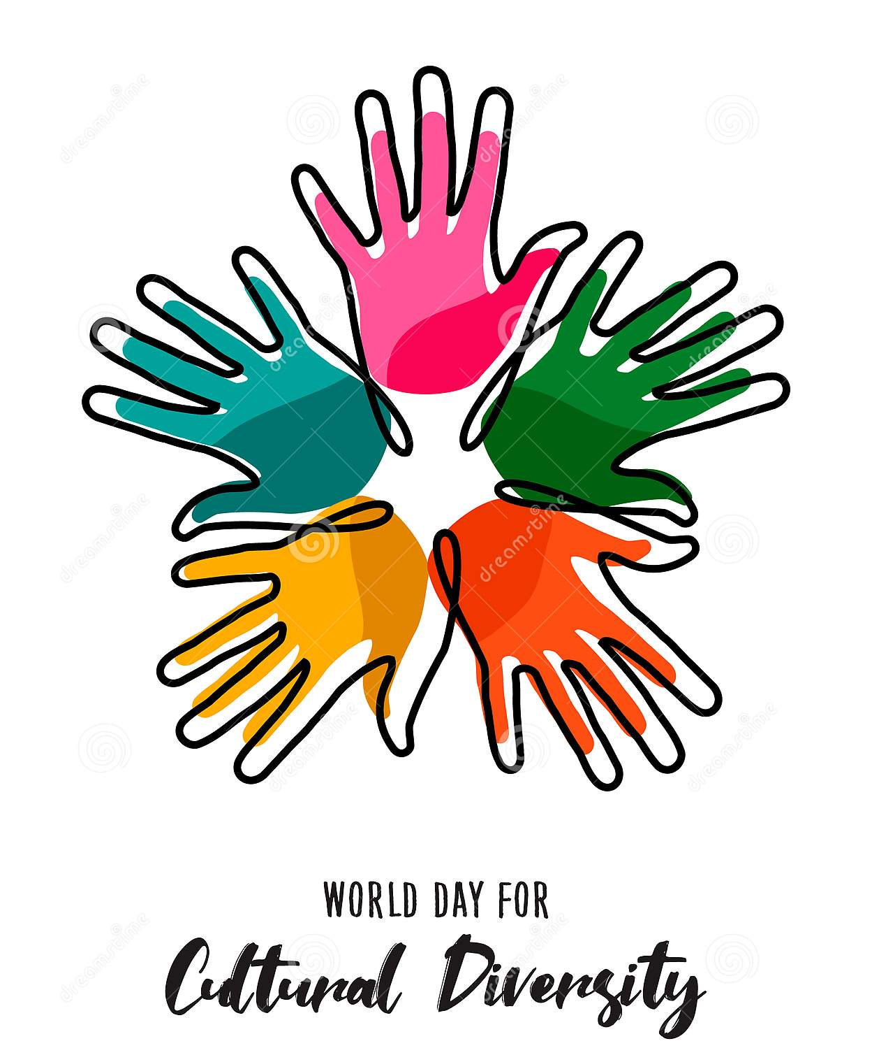
Create a picture to represent diversity using different coloured handprints.

Slide 6
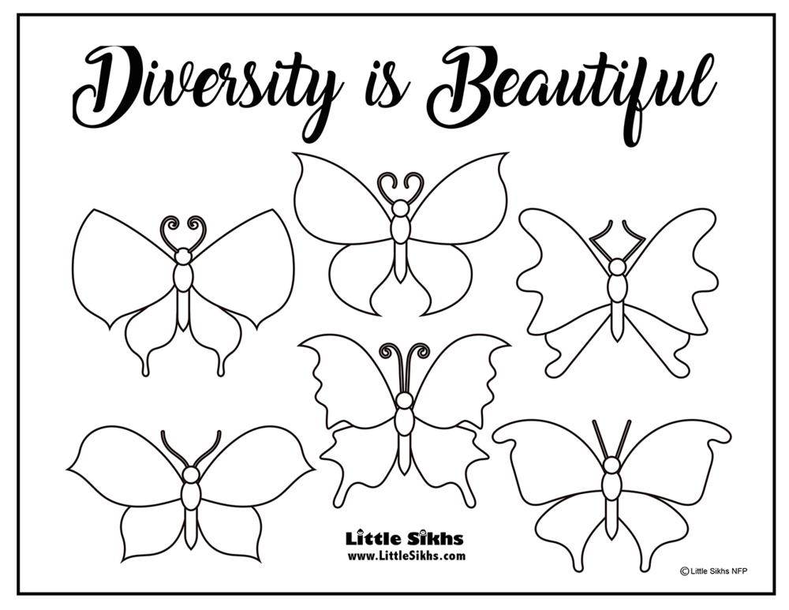

Slide 7
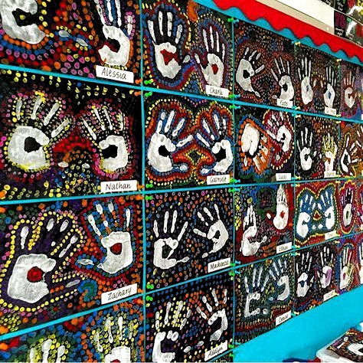
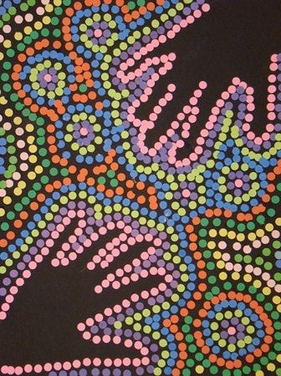
Create a Aboriginal style handprint painting
Paint and print your hands.
Use cotton buds to dab colours of paints around the hands creating exciting patterns using lots of bright colours.

Slide 8
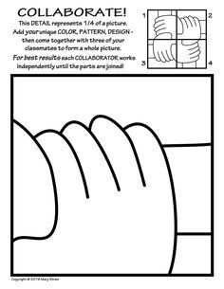
Create a picture to represent unity.
Print off the picture x4 and colour, paint, collage each one differently.
Put the pictures together once they are finished to see what they look like.

